Slide 1
Applied Mechanism Design For Social Good
John P Dickerson
Lecture #29 – 05/11/2021
CMSC828M
Tuesdays & Thursdays
2:00pm – 3:15pm

Slide 2
Fairness, Accountability, And Transparency in AI/Stats/ML
Slide and discussion thanks: Alan Fern, Moritz Hardt, Travis Mandel, Jamie Morgenstern, Aaron Roth, Hakim Weatherspoon

Slide 3
Markov Decision Processes (MDP)
A simulation-based representation gives: S, A, R, T, S₀:
finite state set S (|S|=n and is generally very large)
finite action set A (|A|=m and will assume is of reasonable size)
|S| is too large to provide a matrix representation of R, T, and S₀
A simulation based representation provides us with callable functions for R, T, and S₀.
Think of these as any other library function that you might call
Our planning algorithms will operate by repeatedly calling those functions in an intelligent way

Slide 4
MDP: Simulation-Based Representation
A simulation-based representation gives: S, A, R, T, S₀:
finite state set S (|S|=n and is generally very large)
finite action set A (|A|=m and will assume is of reasonable size)
Stochastic, real-valued, bounded reward function R(s,a) = r
Stochastically returns a reward r given input s and a
Stochastic transition function T(s,a) = s’ (i.e. a simulator)
Stochastically returns a state s’ given input s and a
Probability of returning s’ is dictated by Pr(s’ | s,a) of MDP
Stochastic initial state function S₀
Stochastically returns a state according to an initial state distribution

Slide 5
General Online Learning
Observe observations
Observe Loss/Reward Function
Receives Loss/Reward
ML Algorithm
Selects output

Slide 6
Typical Assumption: Statistical Feedback
Instances and labels drawn from a fixed distribution D

Slide 7

Alternate Assumption: Adversarial Feedback
Instances and labels drawn adversarially
Spam detection
Anomaly detection
Change over time will be a huge issue!

Slide 8
How can we measure performance?
What we want to maximize: sum of rewards
Why could this be a problem ?????????
Rewards in the future are worth less than rewards now
Finance: interest, inflation
Medicine: health decays over time
Uncertainty, etc

Slide 9

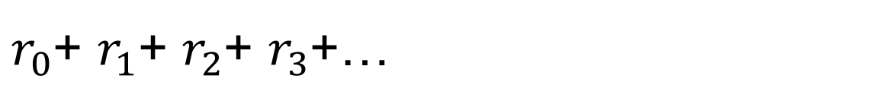
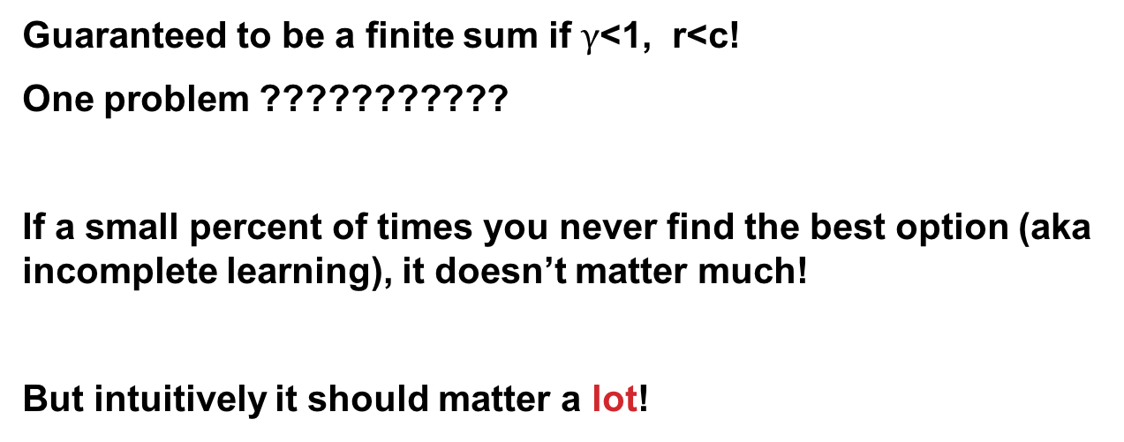
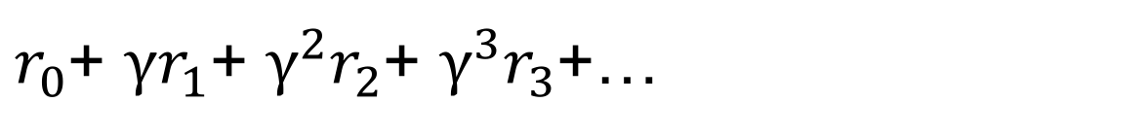
Alternative: Discounted Sum of Rewards
$r_{0}$+ $r_{1}$+ $r_{2}$+ $r_{3}$+…
$r_{0}$+ ${γr}_{1}$+ ${γ^{2}r}_{2}$+ $γ^{3}r_{3}$+…
Guaranteed to be a finite sum if $γ$<1, r<c!
One problem ???????????
If a small percent of times you never find the best option (aka incomplete learning), it doesn’t matter much!
But intuitively it should matter a lot!

Slide 10
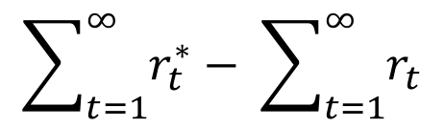
Alternative: Regret
Sum of rewards compared to the best choice in hindsight!
If training a linear model, optimal weights with overfitting
Can get good regret even if perform very poorly in absolute terms
$$\sum_{t=1}^{∞}{r_{t}^{∗}}− \sum_{t=1}^{∞}{r_{t}}$$

Slide 11
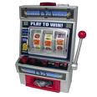
Single State Monte-Carlo Planning
Suppose MDP has a single state and k actions
Can sample rewards of actions using calls to simulator
Sampling action a is like pulling a slot machine arm with random payoff function R(s,a)
s
a₁
a₂
a_{k}
…
R(s,a₁)
R(s,a₂)
…
R(s,a_{k})
Multi-Armed Bandit Problem (MAB)

Slide 12
Multi-Armed Bandits (MAB)
Bandit algorithms are not just useful as components for multi-state Monte-Carlo planning
Pure bandit problems arise in many applications
Applicable whenever:
We have a set of independent options with unknown utilities
There is a cost for sampling options or a limit on total samples
Want to find the best option or maximize utility of our samples
(Later: subject to some fairness constraints.)

Slide 13
MAB Examples
Clinical Trials
Arms = possible treatments
Arm Pulls = application of treatment to individual
Rewards = outcome of treatment
Objective = maximize cumulative reward = maximize benefit to trial population (or find best treatment quickly)
Online Advertising
Arms = different ads/ad-types for a web page
Arm Pulls = displaying an ad upon a page access
Rewards = click through
Objective = maximize cumulative reward = maximize clicks (or find best add quickly)

Slide 14
A surprisingly tough problem…
Which arms do I pull such that I minimize regret?
“The problem is a classic one; it was formulated during the war, and efforts to solve it so sapped the energies and minds of Allied analysts that the suggestion was made that the problem be dropped over Germany, as the ultimate instrument of intellectual sabotage. “
[Whittle J. Royal Statistical Society-1979]

Slide 15
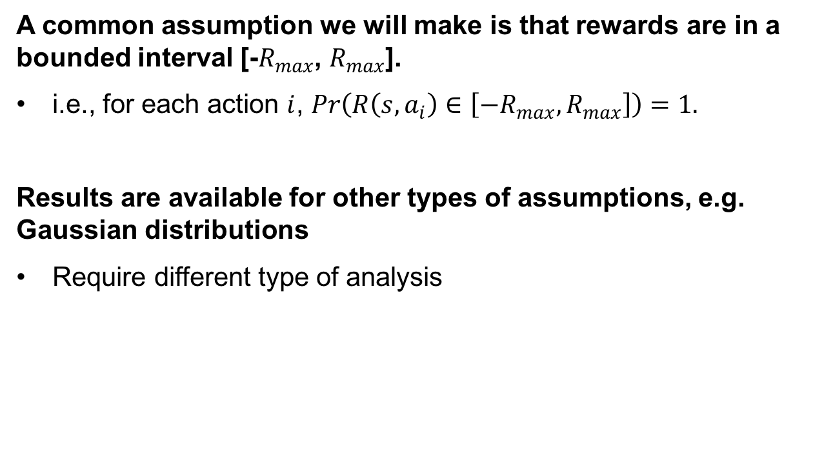
Bounded Reward Assumption
A common assumption we will make is that rewards are in a bounded interval [-$R_{max}$, $R_{max}$].
i.e., for each action $i$, $\operatorname{Pr}\left(R\left(s,a_{i}\right)∈\left[{−R}_{max},R_{max}\right]\right)=1.$
Results are available for other types of assumptions, e.g. Gaussian distributions
Require different type of analysis

Slide 16

MAB algorithm #1: epsilon-first
Phase 1: Explore arms uniformly at random
Phase 2: Exploit best arm so far
Only 1 parameter: how long to wait?
(Aka A/B testing)
Problem ?????????
Not very efficient
But:
Makes statistics easy to run

Slide 17
MAB algorithm #2: Epsilon-greedy
Flip a coin:
With probability ε, explore uniformly
With probability 1 - ε, exploit
Only 1 parameter: ε
Problem ????????
Regret linear in T
But:
Often used in robotics and reinforcement learning

Slide 18

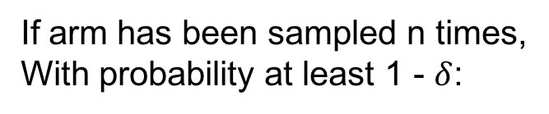
Idea
The problem is uncertainty…
How to quantify uncertainty? Error bars
If arm has been sampled n times,
With probability at least 1 - $δ$:
$$\left|\hat{μ}−μ\right|< \sqrt{\frac{log⁡(\frac{2}{δ})}{2n}}$$

Slide 19
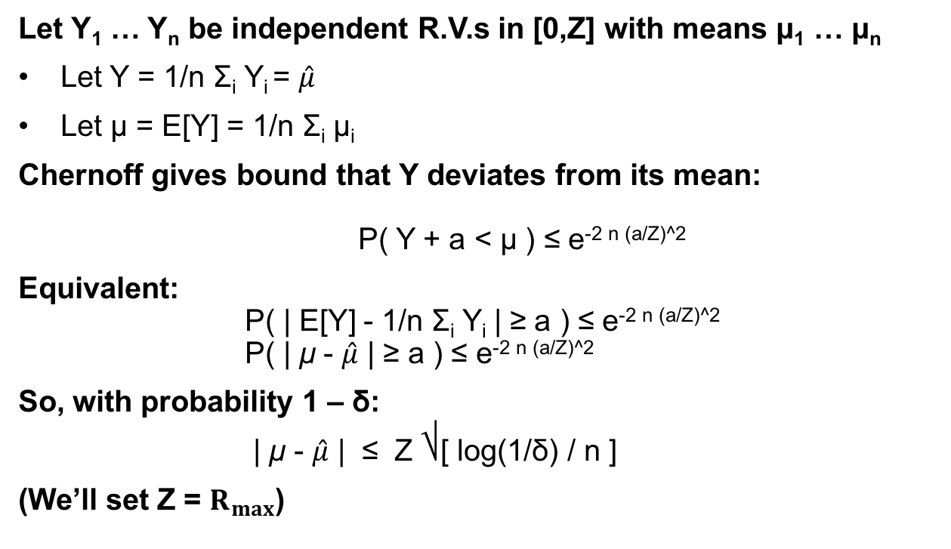
How? Chernoff-Hoeffding Bounds
Let Y₁ … Y_{n} be independent R.V.s in [0,Z] with means μ₁ … μ_{n}
Let Y = 1/n Σ_{i} Y_{i} = $\hat{μ}$
Let μ = E[Y] = 1/n Σ_{i} μ_{i}
Chernoff gives bound that Y deviates from its mean: P( Y + a < μ ) ≤ e^{-2 n (a/Z)^2}
Equivalent: P( | E[Y] - 1/n Σ_{i} Y_{i} | ≥ a ) ≤ e^{-2 n (a/Z)^2} P( | μ - $\hat{μ}$ | ≥ a ) ≤ e^{-2 n (a/Z)^2}
So, with probability 1 – δ:
| μ - $\hat{μ}$ | ≤ Z ⎷[ log(1/δ) / n ]
(We’ll set Z = $R_{max}$)

Slide 20
Given Error bars, how do we act?

Slide 21
Given Error bars, how do we act?
Optimism under uncertainty!
Why? If bad, we will soon find out!
Notes:
“Despite our lack of knowledge in what actions are best we will construct an optimistic guess as to how good the expected payoff of each action is, and pick the action with the highest guess. If our guess is wrong, then our optimistic guess will quickly decrease and we’ll be compelled to switch to a different action. But if we pick well, we’ll be able to exploit that action and incur little regret.” -- Jeremy Kun’s blog

Slide 22

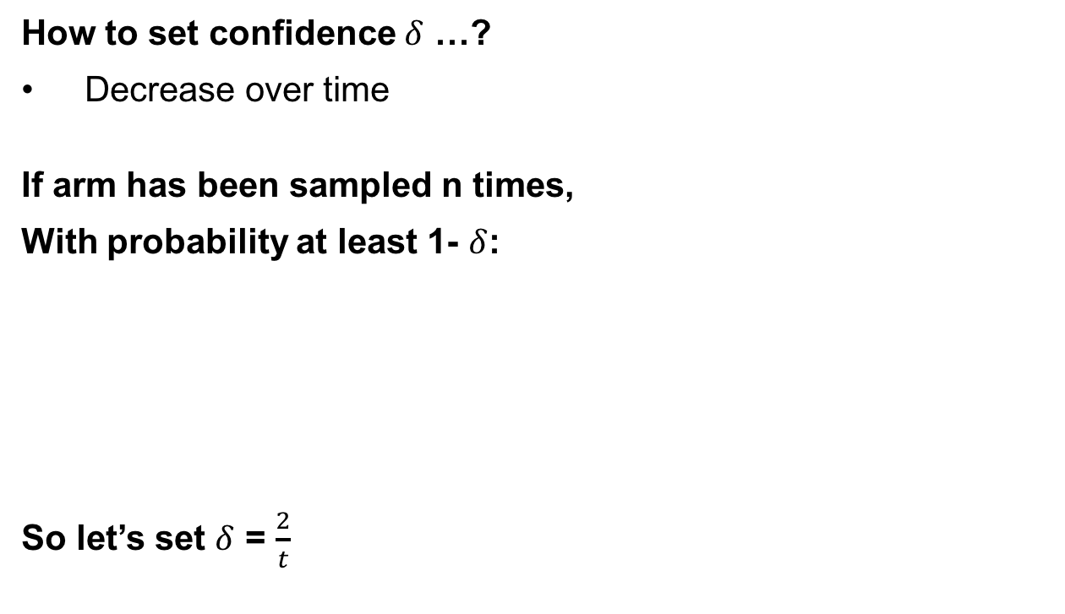
One last wrinkle
How to set confidence $δ$ …?
Decrease over time
If arm has been sampled n times,
With probability at least 1- $δ$:
So let’s set $δ$ = $\frac{2}{t}$
$$\left|\hat{μ}−μ\right|< \sqrt{\frac{log⁡(\frac{2}{δ})}{2n}}$$

Slide 23
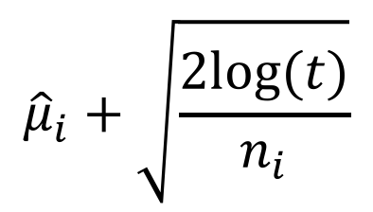
Upper Confidence Bound (UCB)
1. Play each arm once
2. Play arm i that maximizes:
3. Repeat Step 2 forever
Note that bound increases with t as we don’t play arm i, but also increases with the empirical mean of i
Explore vs. exploit
$${\hat{μ}}_{i}+\sqrt{\frac{2log⁡(t)}{n_{i}}}$$

Slide 24
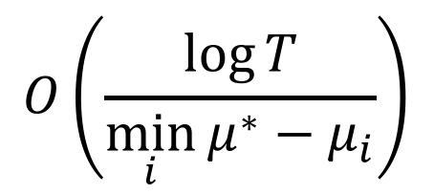
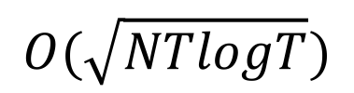
UCB Regret Bound
Problem-independent: “no regret”
Problem-dependent:
Can’t do much better!
$$O(\sqrt{NTlogT})$$
$$O\left(\frac{\log{T}}{\min_{i}{μ^{∗}−μ_{i}}}\right)$$

Slide 25
Contextual Bandits
Scenarios
In personalized news article recommendation the task is to select, from a pool of candidates, a news article to display whenever a new user visits a website. The articles correspond to arms, and a reward is obtained whenever the user clicks on the selected article.
Side information (context)
For the user this may include historical activities, demographic information, and geolocation;
For the articles, we may have content information and categories.
Model
The world announces some context information x (think of this as a high dimensional bit vector if that helps).
A policy chooses arm a from 1 of k arms (i.e. 1 of k ads).
The world reveals the reward r_{a} of the chosen arm (i.e. whether the ad is clicked on).

Slide 26



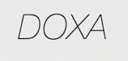





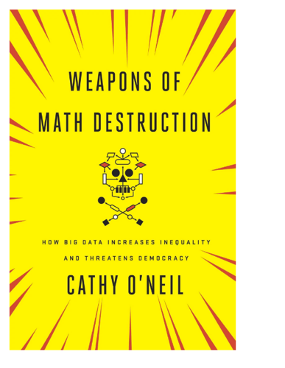
Automated decisions of consequence
[Sweeney 2013, Miller 2015, Byrnes 2016,
Rudin 2013, Barry-Jester et al. 2015]
Hiring
Lending
Policing/
sentencing
Search for minority names →
ads for DUI/arrest records
Female cookies →
less freq. shown professional job opening ads

Slide 27
“… a lot remains unknown about how big data-driven decisions may or may not use factors that are proxies for race, sex, or other traits that U.S. laws generally prohibit from being used in a wide range of commercial decisions … What can be done to make sure these products and services–and the companies that use them treat consumers fairly and ethically?”
- FTC Commissioner Julie Brill [2015]

Slide 28
Obvious sources of bias against minorities
Less data about smaller populations, harder to learn about
Less important to learn about (w.r.t. objective function)
Using “one model” which ignores “sensitive” traits
Training data the result of historical inequities
Data feedback loops: only observe/update estimates for individuals current model believes are high-quality

Slide 29
Fairness
A new notion of fairness:
What is the “cost” of this constraint with respect to regret minimization?
high-quality individuals must be treated better than lower-quality individuals
Covers work from [Joseph, Kearns, Morgenstern, Roth NIPS-16], thanks to Jamie Morgenstern for the base slides!

Slide 30
A running example: loans
Each arm represents a population,
Each day we choose 1 of k individuals
Can only favor arm A over B if confident that …
Population A is better
(classic bandit setting)
A’s individual on day t is better than B’s individual on day t
(contextual bandit setting)

Slide 31
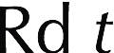
Recall: classical aka non-contextual setting

Slide 32
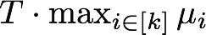
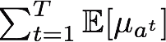
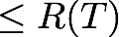
Recall: Measuring performance
E[total reward of best arm for T days]
-
E[total reward of A’s T choices]

Slide 33
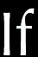
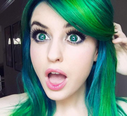
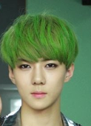

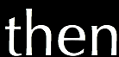
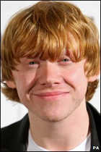
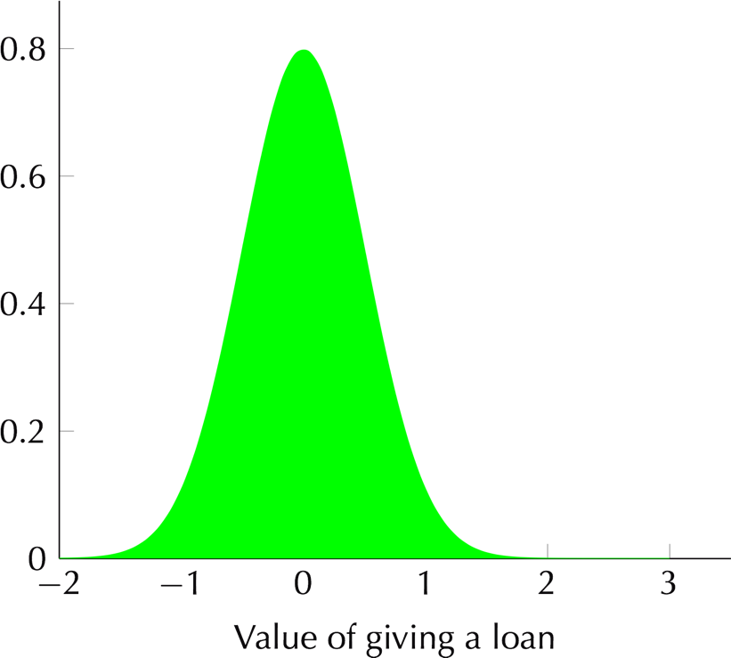
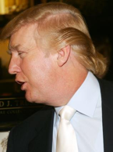
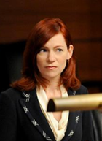
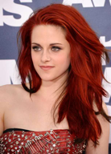
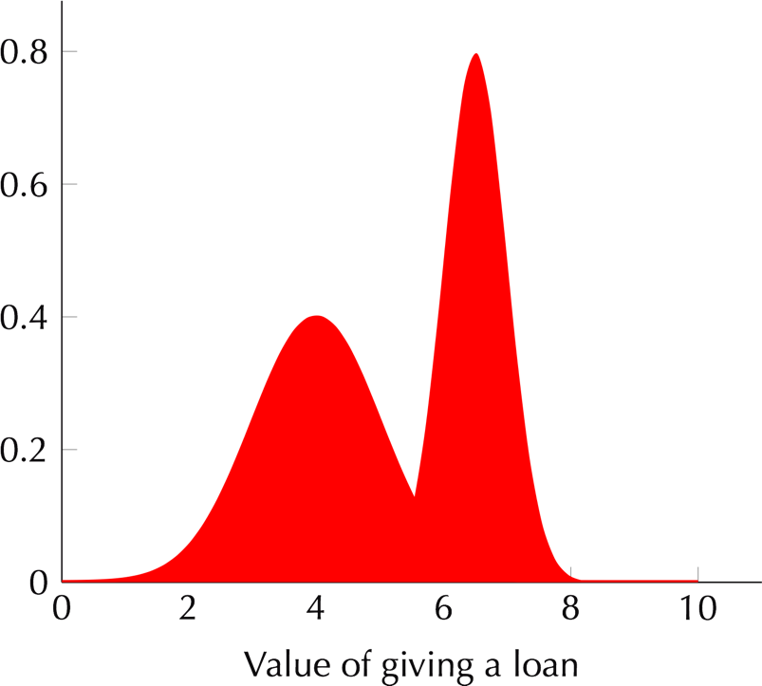
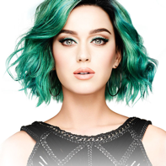
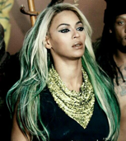
Fairness w.r.t “arms”

Slide 34
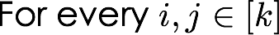
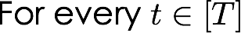
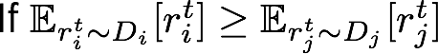
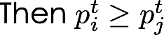


Fairness Definition

Slide 35
Price of fairness
What is the cost of fairness in terms of regret minimization?
Regret-minimizing algorithms are ‘fair in the limit’…
???????????????
What about before the limit?

Slide 36
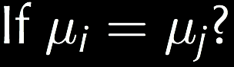

Fairness Definition

Slide 37
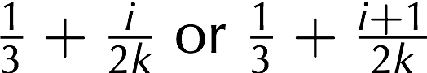
Where does cost of fairness come from?
Distribution over instances
k Bernoulli arms
Only uncertainty is their means
Arm i has mean μi which is either

Slide 38

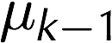
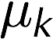
Lower bound particulars
bk
Must play w. =
probability until confident they’re different
bk-1
b’k
b’k-1
Mean of Distribution

Slide 39
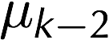
Lower bound particulars
Must play w. =
probability until confident they’re different
bk-1
bk-2
b’k-1
Mean of Distribution
b’k-2

Slide 40
Lower bound particulars
Must play w. =
probability until confident they’re different
Mean of Distribution

Slide 41
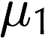
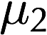
Lower bound particulars
Must play w. =
probability until confident they’re different
Mean of Distribution
b2
b1
b’2
b’1

Slide 42
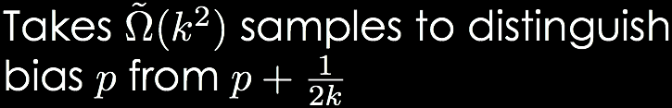
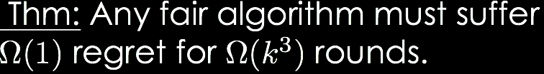
Lower bound particulars
pk
Must play w. =
probability until confident they’re different
pk-1
p’k
Mean of Distribution
p’k-1
p2
p1
p’2
p’1

Slide 43
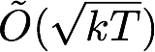
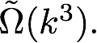
So, there’s a separation between fair/unfair learning
Without fairness one can achieve regret
but this lower bound implies fair regret of

Slide 44

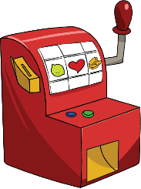


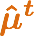
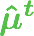
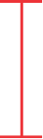
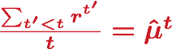






FairUCB
If two intervals overlap,
don’t know which is better.
If two intervals overlap,
play with = probability
Reward
“Standard”
choice
[Auer et al ’02]
What
about
me?
44￼

Slide 45


FairUCB pseudocode

Slide 46




FairUCB Theorem

Slide 47
Price of Fairness
Thus, the cost of fairness in the classic setting is polynomial, with k^{3/2}⎷T vs k^{1/2} ⎷T
Not too bad?
Depends on application area, T, etc.

Slide 48

Contextual no-regret learning
Loan example: Mapping of a group i’s attribute vector to quality aka probability of repaying the loan

Slide 49


Measuring performance: Contextual
for any sequence of k * T contexts,
E[total reward of best choices]
-
E[total reward of A’s choices]

Slide 50




Fairness Definition
Must be quite confident about fi, fj
to prefer one over the other

Slide 51


Results from [Joseph et al. NIPS-16]

Slide 52
Other Fairness Definitions in ML
Can we play around with the context itself?
First approach: fairness through blindness
Assert that an algorithm “doesn’t look at” protected attributes like race, gender, sex, disabilities, etc
Failure points ??????????
So-called redundant encodings tend to exist
It’s very easy to get signal on protected attributes from other attributes
E.g., P(Male) = 0.5, but P(Male | visited http://artofmanliness.com) > 0.5

Slide 53
Other Fairness Definitions in ML
Demographic parity:
A decision (accept/reject loan) is independent of a protected attribute
Decision C = {0,1}, protected attribute A = {0,1}, then:
P{C=1 | A=0} = P{C=1 | A=1}
Problems ????????
Hard to make this truly represent fairness!
Can select qualified applicants in A=1 and unqualified applicants in A=0
E.g., an expensive hotel sends promotions to wealthy whites at an equal rate as less affluent blacks
P{C=1 | A=0} = P{C=1 | A=1}, but one group is much more likely to act on the promotion than the other

